Slide 1
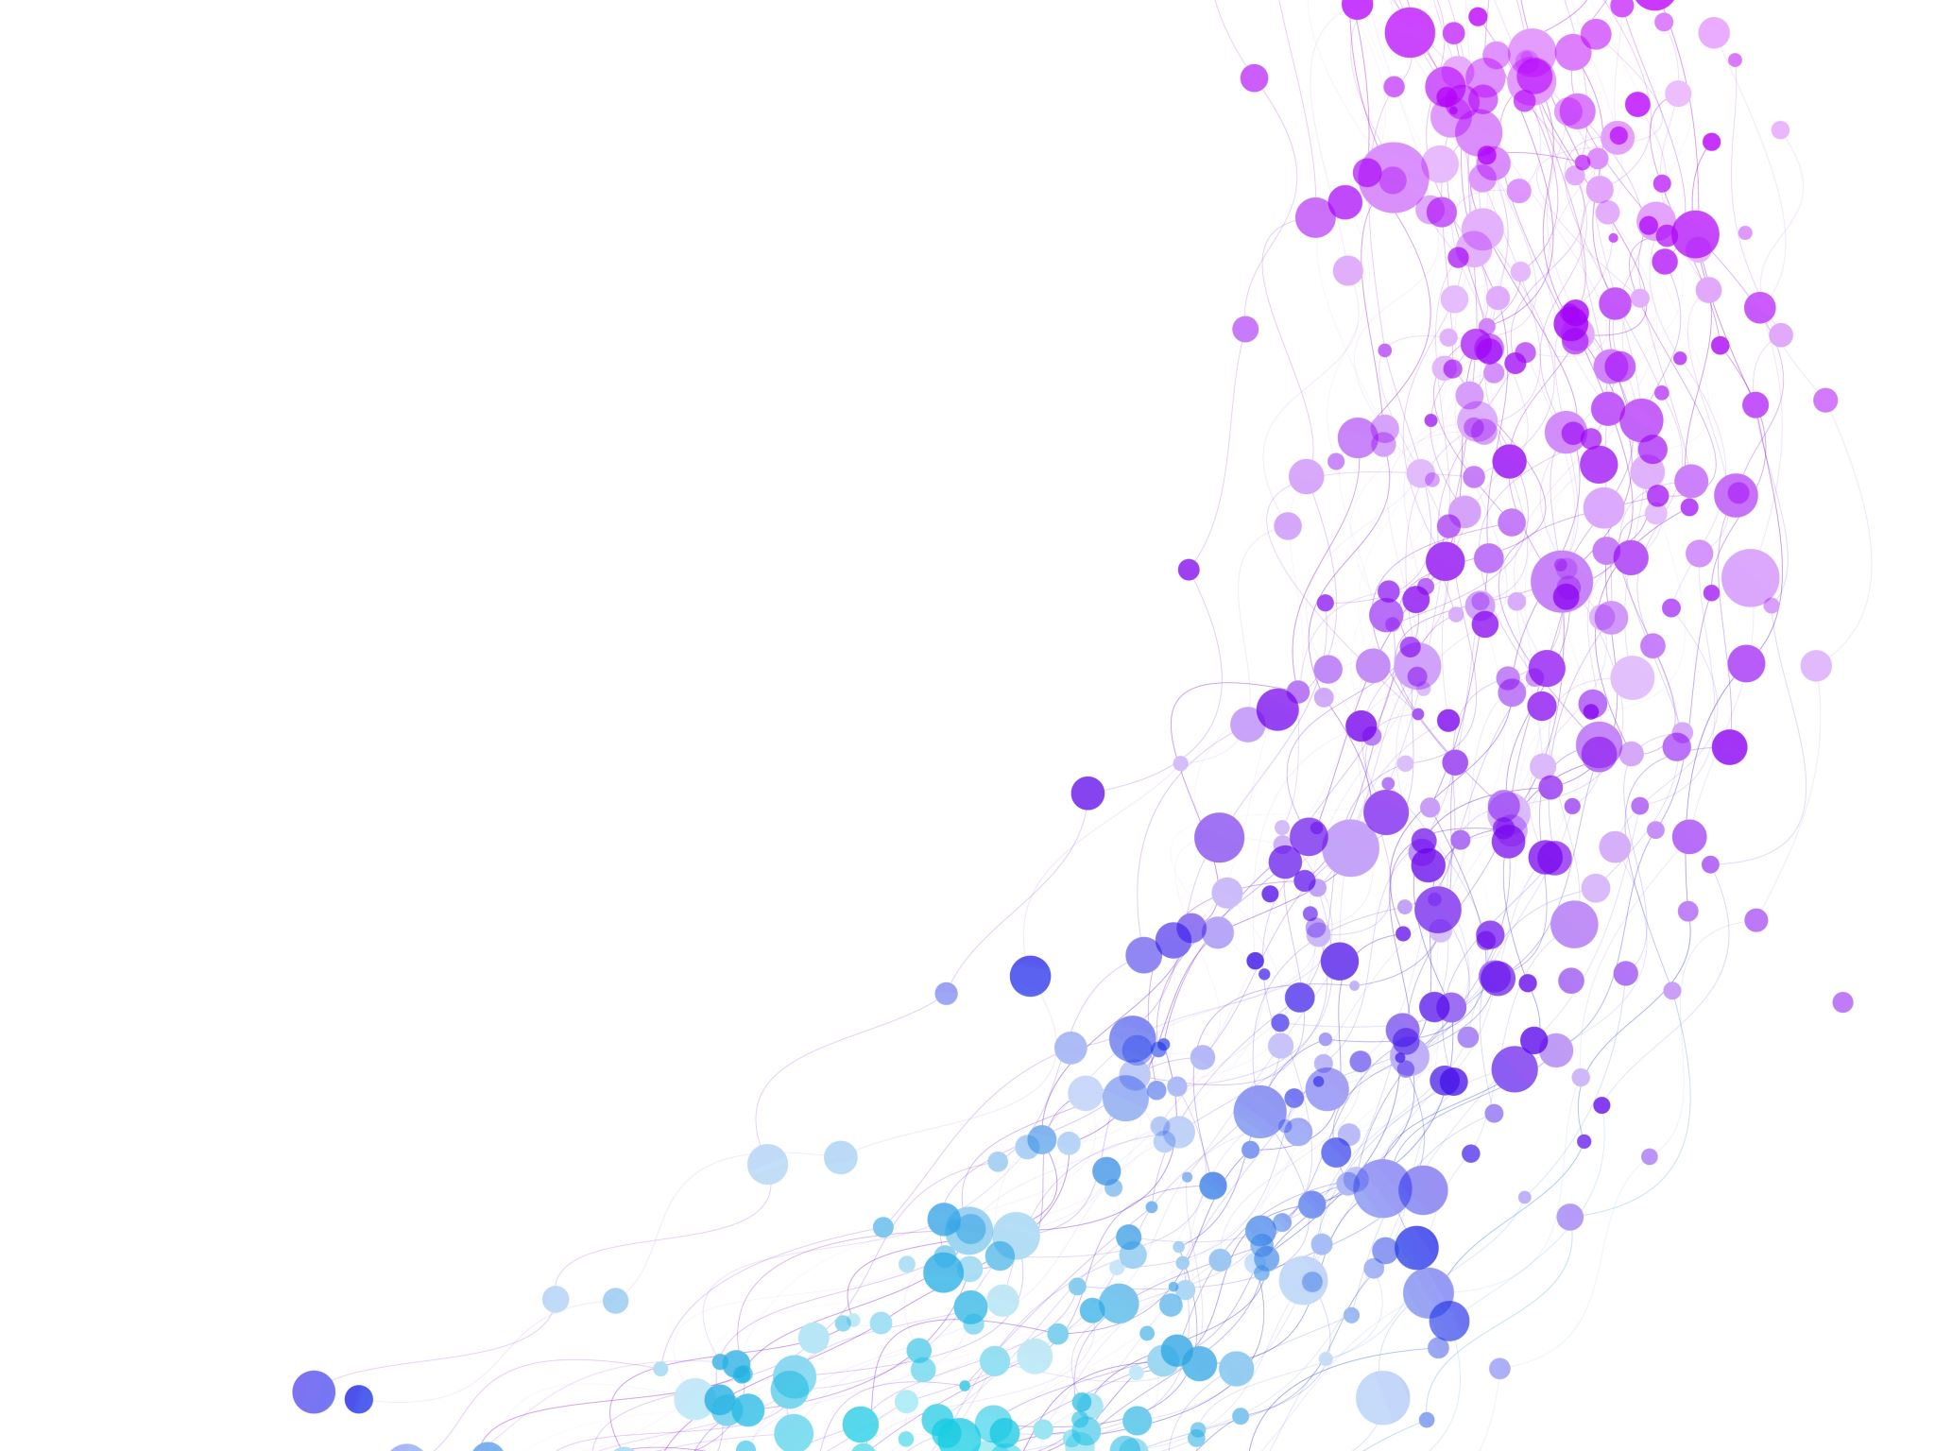

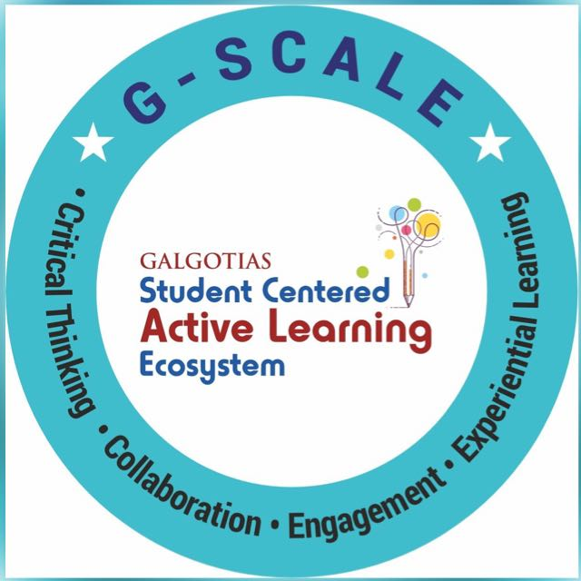
Lecture-3 Database system concept and architecture Dr. Shipra Shukla GUSCSE202534219

Slide 2
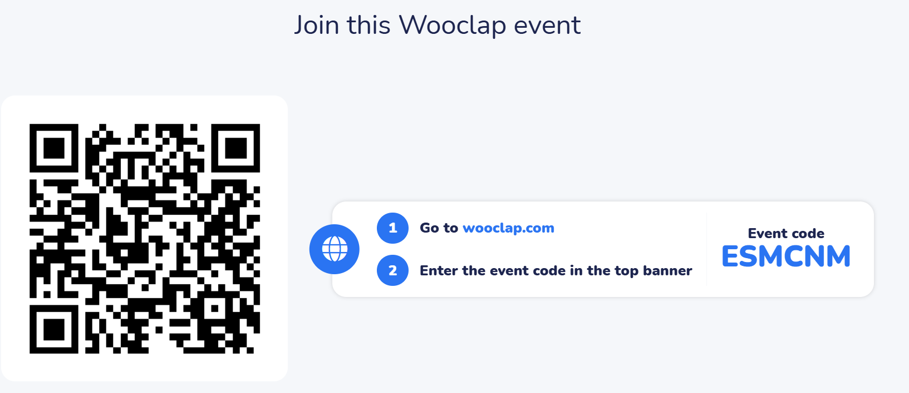
Pre-assessment

Slide 3
Prerequisites: Database Concepts
Database: Collection of related data.

Slide 4
LEARNING OUTCOMES
By the end of this lesson, the students should be able to:
Integrate and relate the concepts of DBMS architecture and levels of abstraction to explain how they collectively ensure data independence and efficient database management.

Slide 5
Session Outline
1. What is DBMS
2. What is Database System Architecture and its types?
3. Levels and Data Independence
4. Conclusion
5. What’s Next?

Slide 6
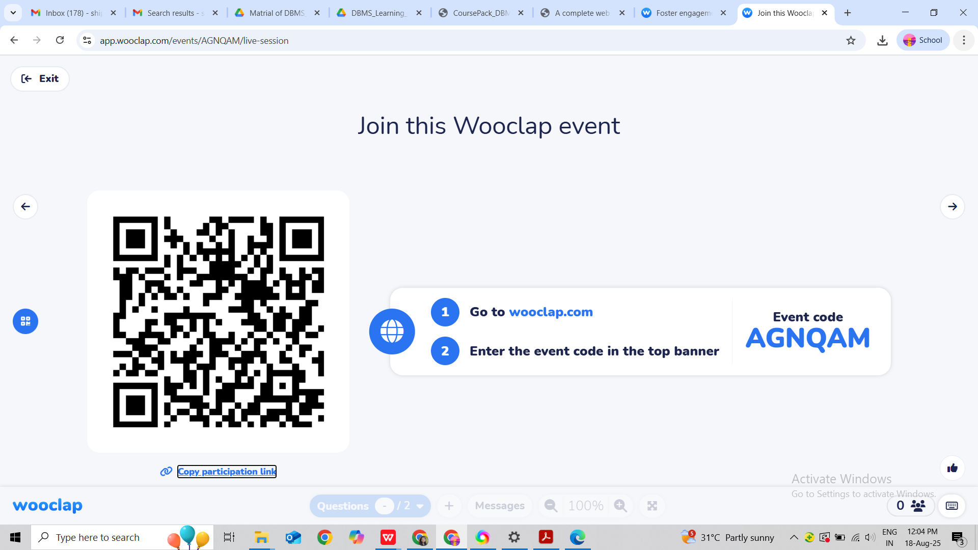
Opening Question:Think-Pair-Share

Slide 7
DBMS: Software for managing databases.
Key Functions of DBMS:
Data storage, retrieval, update
User access control
Transaction management
Backup & recovery
Examples: MySQL, Oracle, MongoDB.

Slide 8
What is Database System Architecture?
The blueprint of how a database system is organized — how different components (software, storage, users, and processes) interact to store, manage, and retrieve data efficiently.
Think of it like the floor plan of a library:
How books are stored (data storage)
How the catalog works (data model)
How you request a book (queries)
How the librarian finds and gives it to you (query processor & storage manager)

Slide 9
Levels of Abstraction
External Level (User Views): Different views for users (e.g., cashier vs. manager in a bank).
Conceptual Level (Logical View): Community-wide view of the entire database.
Internal Level (Physical Storage): How data is actually stored.

Slide 10
ACTIVITY1:
JIGSAW
For the following terms match the definitions : Data, Information, File System, DBMS, Schema.

Slide 11
Main Components
Purpose: Separate how data is stored, how it’s structured, and how users see it.
[External Views] <-- Multiple user perspectives
↑
[Conceptual Schema] <-- Logical database structure
↑
[Internal Schema] <-- Physical storage details

Slide 12
Levels of Abstraction (Three-Level Architecture )
How data is actually stored in memory/disk (files, indexes, records).
Example: On disk, a table may be split into pages and blocks.

Slide 13
Activity 2: Think -Pair-Share
"If the database storage changes (like new hardware), should the user queries change? What will happen ?"

Slide 14
Concept of Data Independence:
Logical Data Independence
Physical Data Independence

Slide 15
Data Models
They define how data is represented and organized.
Hierarchical – tree structure
Network – graph structure
Relational – tables (most common)
Object-Oriented – with objects & methods
Document – JSON/XML documents (NoSQL)

Slide 16
DBMS Architecture Types
Centralized – All data and DBMS on one machine.
Client–Server – Client sends queries, server processes them.
Distributed – Data is stored across multiple locations.

Slide 17

Reflections:
Explain in 2–3 sentences how DBMS architecture ensures data independence

Slide 18
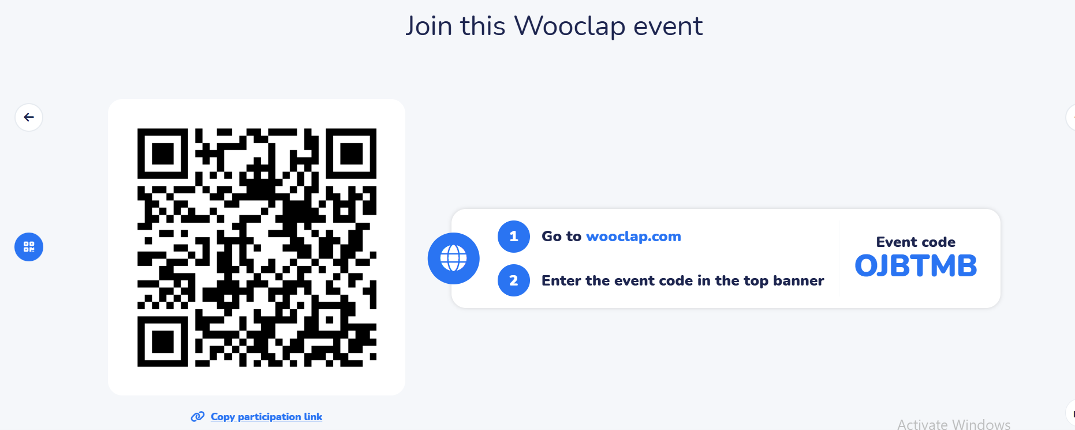
Post Assessment: Quiz

Slide 19
Thankyou

